Slide 1
Added Mass
Rodney Metoyer

Slide 2
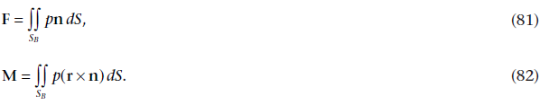


Added Mass in Potential Flow [1]
S_{B} = Body Surface
S_{C} = Control Surface
Applying Bernoulli and Gauss (see [1] for details)
For a large control volume the contribution from the integrals over S_{C} vanishes.
D’Alembert’s paradox – see pg. 142-3 for how rxn is dependent on time.
[1] J. N. Newman and J. Grue, Marine hydrodynamics, 40th anniversary edition. Cambridge, Massachusetts: The MIT Press, 2017.

Slide 3

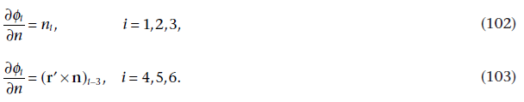
Added Mass in Potential Flow Continued
Boundary Condition (r’ is the vector from the center of rotation)
Redundant notation
is satisfied by
if

Slide 4
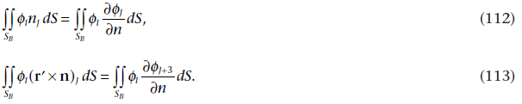


Added Mass in Potential Flow Continued
From the boundary conditions
The added mass tensor
Finally

Slide 5
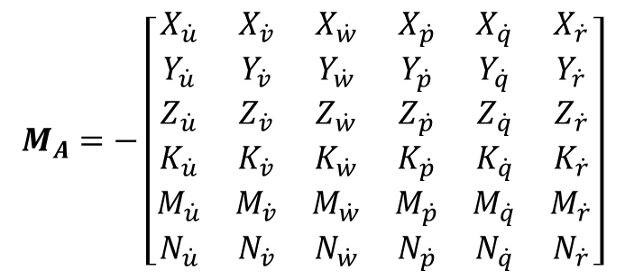
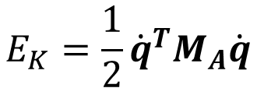
The “Added Mass” Hydrodynamic Force
Added mass is modeled as a perceived change in mass due to the inertia of the fluid
‘Apparent mass force’ is a better name
$$M_{A}=−\left[\begin{matrix}X_{\dot{u}} & X_{\dot{v}} & X_{\dot{w}} & X_{\dot{p}} & X_{\dot{q}} & X_{\dot{r}} \\ Y_{\dot{u}} & Y_{\dot{v}} & Y_{\dot{w}} & Y_{\dot{p}} & Y_{\dot{q}} & Y_{\dot{r}} \\ Z_{\dot{u}} & Z_{\dot{v}} & Z_{\dot{w}} & Z_{\dot{p}} & Z_{\dot{q}} & Z_{\dot{r}} \\ K_{\dot{u}} & K_{\dot{v}} & K_{\dot{w}} & K_{\dot{p}} & K_{\dot{q}} & K_{\dot{r}} \\ M_{\dot{u}} & M_{\dot{v}} & M_{\dot{w}} & M_{\dot{p}} & M_{\dot{q}} & M_{\dot{r}} \\ N_{\dot{u}} & N_{\dot{v}} & N_{\dot{w}} & N_{\dot{p}} & N_{\dot{q}} & N_{\dot{r}}\end{matrix}\right]$$
The added mass terms are obtained from potential theory [1]
Or alternatively from the kinetic co-energy using Kirchhoff’s equations [2]
$$E_{K}=\frac{1}{2}{\dot{q}}^{T}M_{A}\dot{q}$$
[1] Newman, J.N., Grue, J., 2017. Marine hydrodynamics, 40th anniversary edition. ed. The MIT Press, Cambridge, Massachusetts.
[2] Fossen, T.I., 2011. Handbook of marine craft hydrodynamics and motion control. Wiley, Chichester, West Sussex.

Slide 6
Added Mass is not Additional Mass!!!
The added mass is not a quantity of fluid mass to add to the system
Or as Imlay puts it in the “Some Erroneous Concepts” section of his seminal report [3], “the mistake must not be made of assuming that the added mass effects involve only ... the so-called ‘entrained fluid’ erroneously described by some authors.”
The added mass matrix is a convenient way to account for a hydrodynamic force that is proportional to acceleration and analogous to buoyancy
[3] F. Imlay, “The Complete Expression for ‘Added Mass’ of a Rigid Body Moving in an Ideal Fluid,” Research and Development Report, Jul. 1961.

Slide 7
Calculating Added Mass Coefficients
Accuracy of Strip Theory for Prolate Spheroid
a/b = 2
a/b = 10
Strip theory works well for slender bodies!
b
Methods
Analytical
Exact solution for simple geometries
Implicit assumption that body frame origin is at geometric center
Strip Theory
Good for getting in the ballpark
Only works for slender bodies
Panel Methods
Good balance between cost and accuracy
Experimental Methods
Very accurate but can be expensive
a
Method | MA(2,2) | MA(6,6)
Analytical | 1 | 1
Strip Spheroid | 1.42 | 3.34
Method | MA(2,2) | MA(6,6)
Analytical | 1 | 1
Strip Spheroid | 1.041 | 1.121

Slide 8
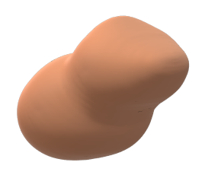


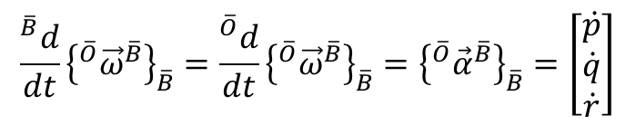


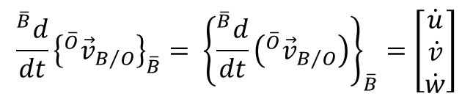






Body Frame Accelerations
The added mass matrix is necessarily defined with respect to a body-fixed frame
In conventional formulations the body frame origin is implicitly located at the center of geometry, but that is not always the case
$${\left\{​^{\overline{O}}{\vec{v}}_{B/O}\right\}}_{\overline{B}}=\left[\begin{matrix}u \\ v \\ w\end{matrix}\right]$$
$${\left\{​^{\overline{O}}{\vec{ω}}^{\overline{B}}\right\}}_{\overline{B}}=\left[\begin{matrix}p \\ q \\ r\end{matrix}\right]$$
$${\vec{k}}_{\overline{B}}$$
$$\left[\begin{matrix}X_{A} \\ Y_{A} \\ Z_{A} \\ K_{A} \\ M_{A} \\ N_{A}\end{matrix}\right]=M_{A}\left[\begin{matrix}\dot{u} \\ \dot{v} \\ \dot{w} \\ \dot{p} \\ \dot{q} \\ \dot{r}\end{matrix}\right]+C_{A}\left(ν\right)ν$$
$$\frac{​^{\overline{B}}d}{dt}{\left\{​^{\overline{O}}{\vec{v}}_{B/O}\right\}}_{\overline{B}}= {\left\{\frac{​^{\overline{B}}d}{dt}\left(​^{\overline{O}}{\vec{v}}_{B/O}\right)\right\}}_{\overline{B}}=\left[\begin{matrix}\dot{u} \\ \dot{v} \\ \dot{w}\end{matrix}\right]$$
$$C$$
$$B$$
$$ν=\left[\begin{matrix}u \\ v \\ w \\ p \\ q \\ r\end{matrix}\right]$$
$$\frac{​^{\overline{B}}d}{dt}{\left\{​^{\overline{O}}{\vec{ω}}^{\overline{B}}\right\}}_{\overline{B}}=\frac{​^{\overline{O}}d}{dt}{\left\{​^{\overline{O}}{\vec{ω}}^{\overline{B}}\right\}}_{\overline{B}}={\left\{​^{\overline{O}}{\vec{α}}^{\overline{B}}\right\}}_{\overline{B}}=\left[\begin{matrix}\dot{p} \\ \dot{q} \\ \dot{r}\end{matrix}\right]$$
$${\vec{i}}_{\overline{B}}$$
$${\vec{j}}_{\overline{B}}$$

Slide 9
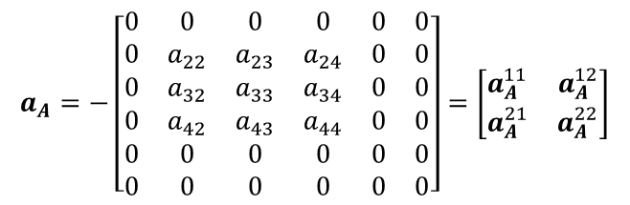
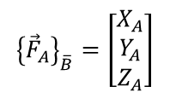
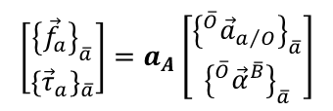

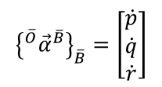
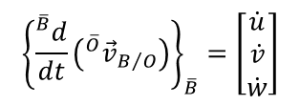
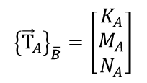
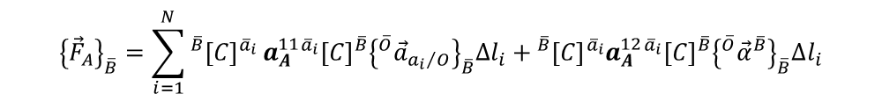
Strip Theory Solution
$$M_{A}=−\left[\begin{matrix}\frac{∂X_{A}}{∂\dot{u}} & \frac{∂X_{A}}{∂\dot{v}} & \frac{∂X_{A}}{∂\dot{w}} & \frac{∂X_{A}}{∂\dot{p}} & \frac{∂X_{A}}{∂\dot{q}} & \frac{∂X_{A}}{∂\dot{r}} \\ \frac{∂Y_{A}}{∂\dot{u}} & \frac{∂Y_{A}}{∂\dot{v}} & \frac{∂Y_{A}}{∂\dot{w}} & \frac{∂Y_{A}}{∂\dot{p}} & \frac{∂Y_{A}}{∂\dot{q}} & \frac{∂Y_{A}}{∂\dot{r}} \\ \frac{∂Z_{A}}{∂\dot{u}} & \frac{∂Z_{A}}{∂\dot{v}} & \frac{∂Z_{A}}{∂\dot{w}} & \frac{∂Z_{A}}{∂\dot{p}} & \frac{∂Z_{A}}{∂\dot{q}} & \frac{∂Z_{A}}{∂\dot{r}} \\ \frac{∂K_{A}}{∂\dot{u}} & \frac{∂K_{A}}{∂\dot{v}} & \frac{∂K_{A}}{∂\dot{w}} & \frac{∂K_{A}}{∂\dot{p}} & \frac{∂K_{A}}{∂\dot{q}} & \frac{∂K_{A}}{∂\dot{r}} \\ \frac{∂M_{A}}{∂\dot{u}} & \frac{∂M_{A}}{∂\dot{v}} & \frac{∂M_{A}}{∂\dot{w}} & \frac{∂M_{A}}{∂\dot{p}} & \frac{∂M_{A}}{∂\dot{q}} & \frac{∂M_{A}}{∂\dot{r}} \\ \frac{∂N_{A}}{∂\dot{u}} & \frac{∂N_{A}}{∂\dot{v}} & \frac{∂N_{A}}{∂\dot{w}} & \frac{∂N_{A}}{∂\dot{p}} & \frac{∂N_{A}}{∂\dot{q}} & \frac{∂N_{A}}{∂\dot{r}}\end{matrix}\right]$$
Another way to write the added mass matrix
where:
$${\left\{{\vec{F}}_{A}\right\}}_{\overline{B}}=\left[\begin{matrix}X_{A} \\ Y_{A} \\ Z_{A}\end{matrix}\right]$$
$${\left\{{\vec{Τ}}_{A}\right\}}_{\overline{B}}=\left[\begin{matrix}K_{A} \\ M_{A} \\ N_{A}\end{matrix}\right]$$
$${\left\{\frac{​^{\overline{B}}d}{dt}\left(​^{\overline{O}}{\vec{v}}_{B/O}\right)\right\}}_{\overline{B}}=\left[\begin{matrix}\dot{u} \\ \dot{v} \\ \dot{w}\end{matrix}\right]$$
$${\left\{​^{\overline{O}}{\vec{α}}^{\overline{B}}\right\}}_{\overline{B}}=\left[\begin{matrix}\dot{p} \\ \dot{q} \\ \dot{r}\end{matrix}\right]$$
The load on the composite body is equal to the sum of the loads on each section. The section load per unit length is given by:
$$a_{A}=−\left[\begin{matrix}0 & 0 & 0 & 0 & 0 & 0 \\ 0 & a_{22} & a_{23} & a_{24} & 0 & 0 \\ 0 & a_{32} & a_{33} & a_{34} & 0 & 0 \\ 0 & a_{42} & a_{43} & a_{44} & 0 & 0 \\ 0 & 0 & 0 & 0 & 0 & 0 \\ 0 & 0 & 0 & 0 & 0 & 0\end{matrix}\right]=\left[\begin{matrix}a_{A}^{11} & a_{A}^{12} \\ a_{A}^{21} & a_{A}^{22}\end{matrix}\right]$$
$$\left[\begin{matrix}{\left\{{\vec{f}}_{a}\right\}}_{\overline{a}} \\ {\left\{{\vec{τ}}_{a}\right\}}_{\overline{a}}\end{matrix}\right]=a_{A}\left[\begin{matrix}{\left\{​^{\overline{O}}{\vec{a}}_{a/O}\right\}}_{\overline{a}} \\ {\left\{​^{\overline{O}}{\vec{α}}^{\overline{B}}\right\}}_{\overline{a}}\end{matrix}\right]$$
is the section (2D) added mass matrix.
where:
$${\left\{{\vec{F}}_{A}\right\}}_{\overline{B}}=\sum_{i=1}^{N}{​^{\overline{B}}{\left[C\right]}^{{\overline{a}}_{i}}}a_{A}^{11}​^{{\overline{a}}_{i}}{\left[C\right]}^{\overline{B}}{\left\{​^{\overline{O}}{\vec{a}}_{{a_{i}}/O}\right\}}_{\overline{B}}Δl_{i}+​^{\overline{B}}{\left[C\right]}^{{\overline{a}}_{i}}a_{A}^{12}​^{{\overline{a}}_{i}}{\left[C\right]}^{\overline{B}}{\left\{​^{\overline{O}}{\vec{α}}^{\overline{B}}\right\}}_{\overline{B}}Δl_{i}$$
Finally:
and
$${\left\{{\vec{Τ}}_{A}\right\}}_{\overline{B}}=\sum_{i=1}^{N}{​^{\overline{B}}{\left[C\right]}^{{\overline{a}}_{i}}}a_{A}^{21}​^{\overline{a}}{\left[C\right]}^{\overline{B}}{\left\{​^{\overline{O}}{\vec{a}}_{a/O}\right\}}_{\overline{B}}Δl_{i}+​^{\overline{B}}{\left[C\right]}^{{\overline{a}}_{i}}a_{A}^{22}​^{\overline{a}}{\left[C\right]}^{\overline{B}}{\left\{​^{\overline{O}}{\vec{α}}^{\overline{B}}\right\}}_{\overline{a}}Δl_{i}+\left[{\left\{{\vec{r}}_{{a_{i}}/B}\right\}}_{\overline{B}}×\right]​^{\overline{B}}{\left[C\right]}^{{\overline{a}}_{i}}a_{A}^{11}​^{{\overline{a}}_{i}}{\left[C\right]}^{\overline{B}}{\left\{​^{\overline{O}}{\vec{a}}_{{a_{i}}/O}\right\}}_{\overline{B}}Δl_{i}+\left[{\left\{{\vec{r}}_{{a_{i}}/B}\right\}}_{\overline{B}}×\right]​^{\overline{B}}{\left[C\right]}^{{\overline{a}}_{i}}a_{A}^{12}​^{{\overline{a}}_{i}}{\left[C\right]}^{\overline{B}}{\left\{​^{\overline{O}}{\vec{α}}^{\overline{B}}\right\}}_{\overline{B}}Δl_{i}$$

Slide 10
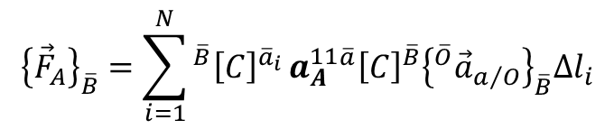
Strip Theory Solution Continued
If the section is symmetrical*, the body force and torque equations reduce to:
$${\left\{{\vec{F}}_{A}\right\}}_{\overline{B}}=\sum_{i=1}^{N}{​^{\overline{B}}{\left[C\right]}^{{\overline{a}}_{i}}}a_{A}^{11}​^{\overline{a}}{\left[C\right]}^{\overline{B}}{\left\{​^{\overline{O}}{\vec{a}}_{a/O}\right\}}_{\overline{B}}Δl_{i}$$
$${\left\{{\vec{Τ}}_{A}\right\}}_{\overline{B}}=\sum_{i=1}^{N}{​^{\overline{B}}{\left[C\right]}^{{\overline{a}}_{i}}}a_{A}^{22}​^{\overline{a}}{\left[C\right]}^{\overline{B}}{\left\{​^{\overline{O}}{\vec{α}}^{\overline{B}}\right\}}_{\overline{a}}Δl_{i}+\left[{\left\{{\vec{r}}_{{a_{i}}/B}\right\}}_{\overline{B}}×\right]​^{\overline{B}}{\left[C\right]}^{{\overline{a}}_{i}}a_{A}^{11}​^{\overline{a}}{\left[C\right]}^{\overline{B}}{\left\{​^{\overline{O}}{\vec{a}}_{a/O}\right\}}_{\overline{B}}Δl_{i}$$
Then we take the partial derivatives of each component with respect to each body frame acceleration to compute the coefficients.
*The symmetrical assumption is not necessary, but it speeds things up, and we do not have a need for asymmetrical sections.

Slide 11
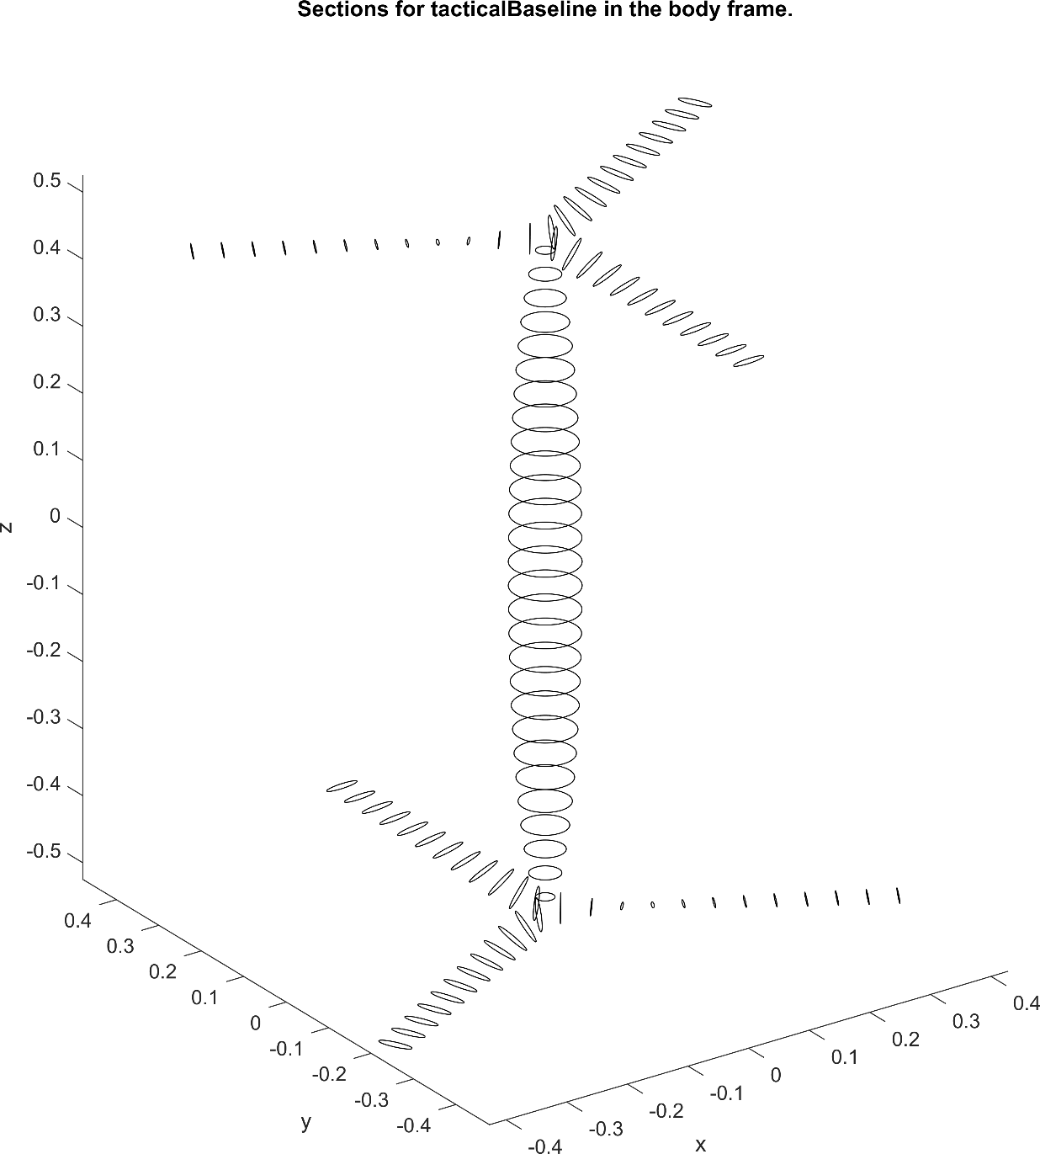
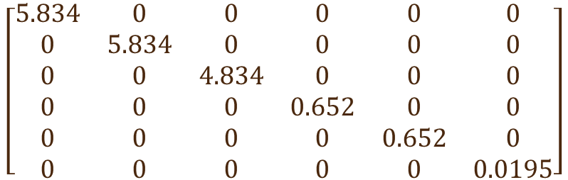
Representative Example
Use ellipses of equivalent chord and thickness to represent the blade sections
Use circles of ellipsoid sections to represent the body
Note that the matrix is only diagonal because of the opposite twists
$$\left[\begin{matrix}5.834 & 0 & 0 & 0 & 0 & 0 \\ 0 & 5.834 & 0 & 0 & 0 & 0 \\ 0 & 0 & 4.834 & 0 & 0 & 0 \\ 0 & 0 & 0 & 0.652 & 0 & 0 \\ 0 & 0 & 0 & 0 & 0.652 & 0 \\ 0 & 0 & 0 & 0 & 0 & 0.0195\end{matrix}\right]$$

Slide 12
Questions
Why can’t we just add some mass?
Hopefully I’ve answered this – added mass coefficients are not mass, they are constants of proportionality that arise from a different physical phenomenon but are also proportional to acceleration
Why is the apparent mass force different when the fluid accelerates compared to when the vehicle accelerates?
Because the physical phenomenon is pressure due to inertia, and the pressure is different when the fluid is accelerating vs. when the body is accelerating
Why is there is a difference between my simulation and someone else’s simulation?
There are three modeling entities that are required for a simulation to exist
Differences in results may arise from differences in any of the models

Slide 13
Three Modeling Entities
Conceptual Model
This is the physical world that you are trying to simulate
Though it should always be defined explicitly, it is often only defined implicitly
This is by far the most difficult model to document, and it is the most important for enabling collaborative development
Simuland is a related concept
Mathematical Model
This is the mathematical model that you are executing in the computer
It is the link between the conceptual model and the computational model
Enables verification (checking that the computer is doing what you think you told it to do)
Computational Model
This is the actual implementation of the conceptual model through execution of the mathematical model
Enables validation (checking that the computer is producing results that align with experimental results)

Slide 14
Origins of Error (or Differences)
Conceptual Model (How we view the world is different/wrong)
I am assuming Newtonian physics whereas Ayaz is incorporating relativistic effects (whose velocity is better?)
James assumes blood flow is constant because only the mean pressure is important for his modeling objectives whereas the pressure waveform is critical for my work (what does pressure mean?)
Mathematical Model
Usually honest misunderstandings and/or negligence
Computational Model
Sources are myriad

Slide 15
Valuable Mitigation Tools
Encapsulation
In my opinion, the most value tools for mitigating error in computational models
Let’s you trade units of code
Unit Tests
Related to encapsulation
Let’s you test units of code
Must be automated to be effective
Documentation
Not just comments (which are a key component of documenting the computational model)

Slide 16
How do we deal with a velocity gradient?
Must account for the spatial change in velocity
or alternatively in the pressure
See Newman pg. 156-9
Still working on the more general case when the added mass matrix has off-diagonal elements.

Slide 17
How do we deal with a velocity gradient?
Buoyancy-like term that arises from non-uniformity in space and/or time.
Note that the analogous Archimedian hydrostatic force would overlook the added-mass coefficient.

Slide 18
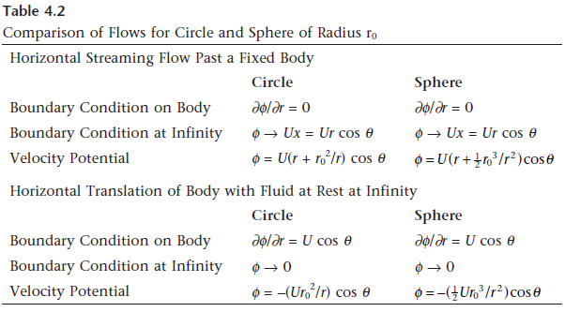
Body moving vs. Fluid moving
Boundary conditions

